Slide 1
FYP: data presentation and review
By: Oisin Watkins

Slide 2
Contents
8-Tap moving average filter
Gaussian Filter
4-Tap moving average filter
1-Tap sliding window filter
Each heading will be broken up into:
Design Concept
Results & Discussion
Brief Wrap Up and Questions

Slide 3
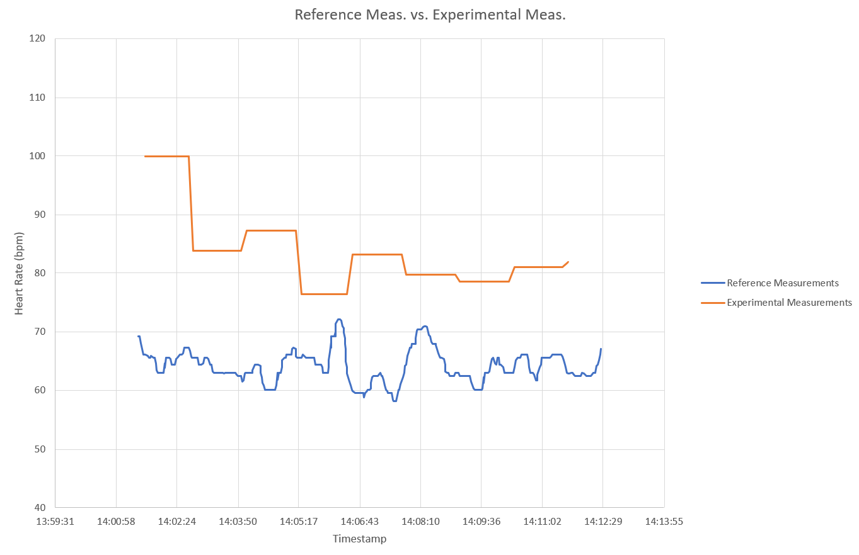

8-Tap moving average filter
The operation of the filter is straightforward: a buffer is filled with the newest 8 heart rate measurements and their average is taken. Below are the results of interest for this filter:
Clearly this design is ineffective at best. The issue arises from the fact that this filter is incredibly slow, due to the long delay between the measurement being taken. This particular filter was only tested at one resolution setting, as attempting a higher resolution would have slowed the process further and likely have performed worse again.

Slide 4
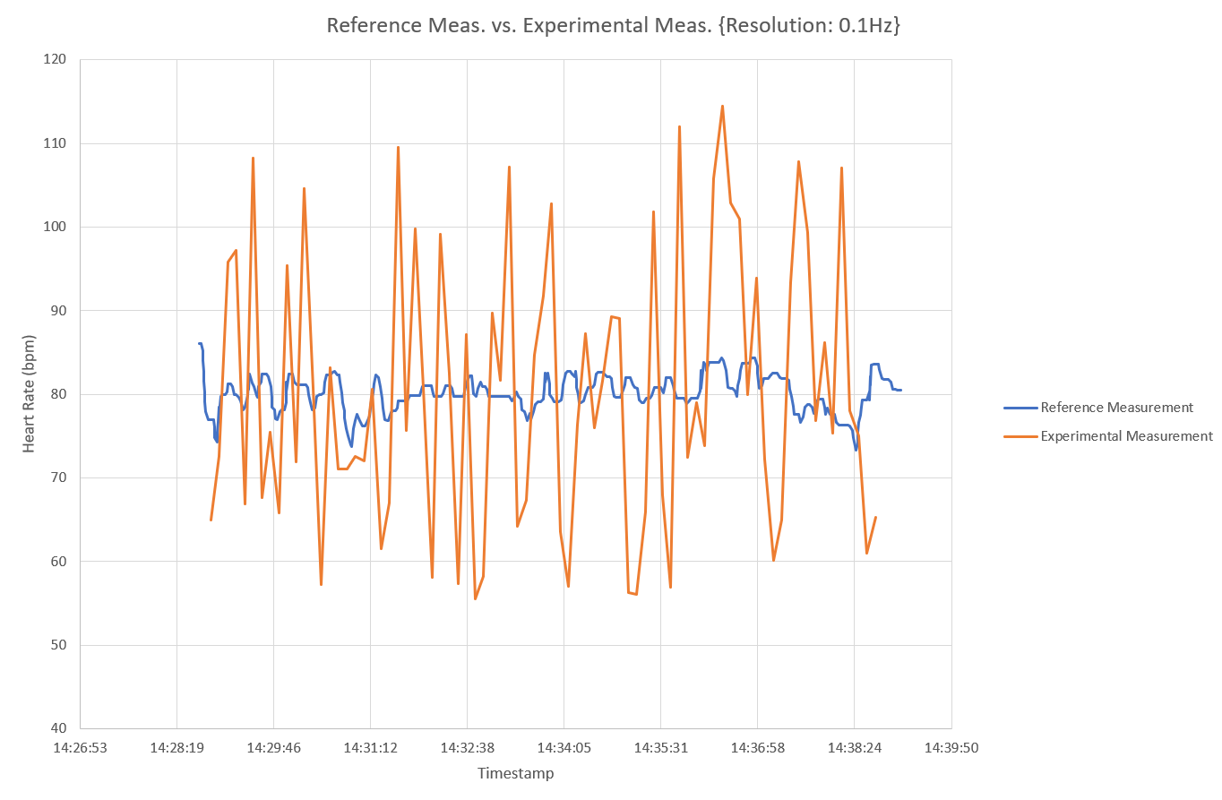
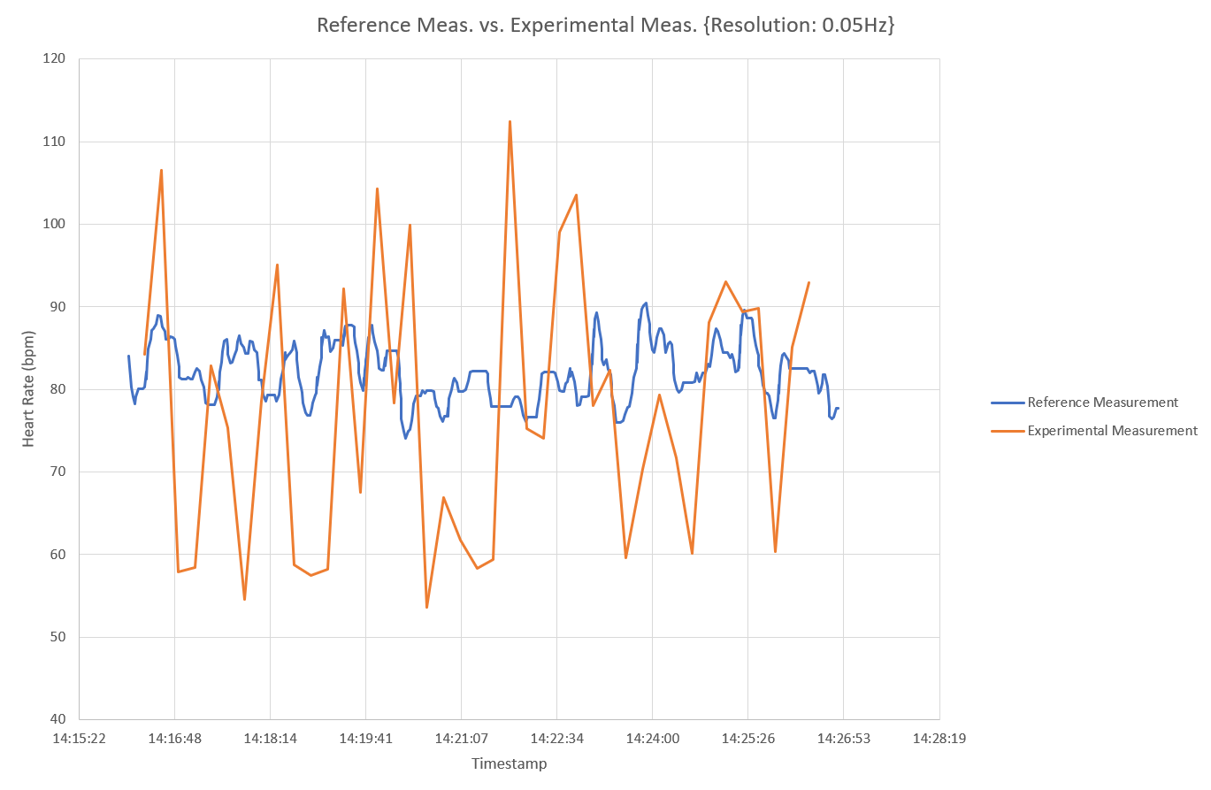


Gaussian filter
Tested at 0.1Hz Resolution and 0.05Hz Resolution. This filter employed an 8-sample long sliding window, placing the newest data at the front of the window and then applying a Gaussian filter to the data. The data for the 0.1Hz resolution and 0.05Hz resolution are listed respectively below:
While the average error has improved, neither the maximum error nor the standard deviation reflect well on this design. While this filter was faster than the previous design the poor performance is likely due to the non-linear behaviour of the Gaussian operation.

Slide 5
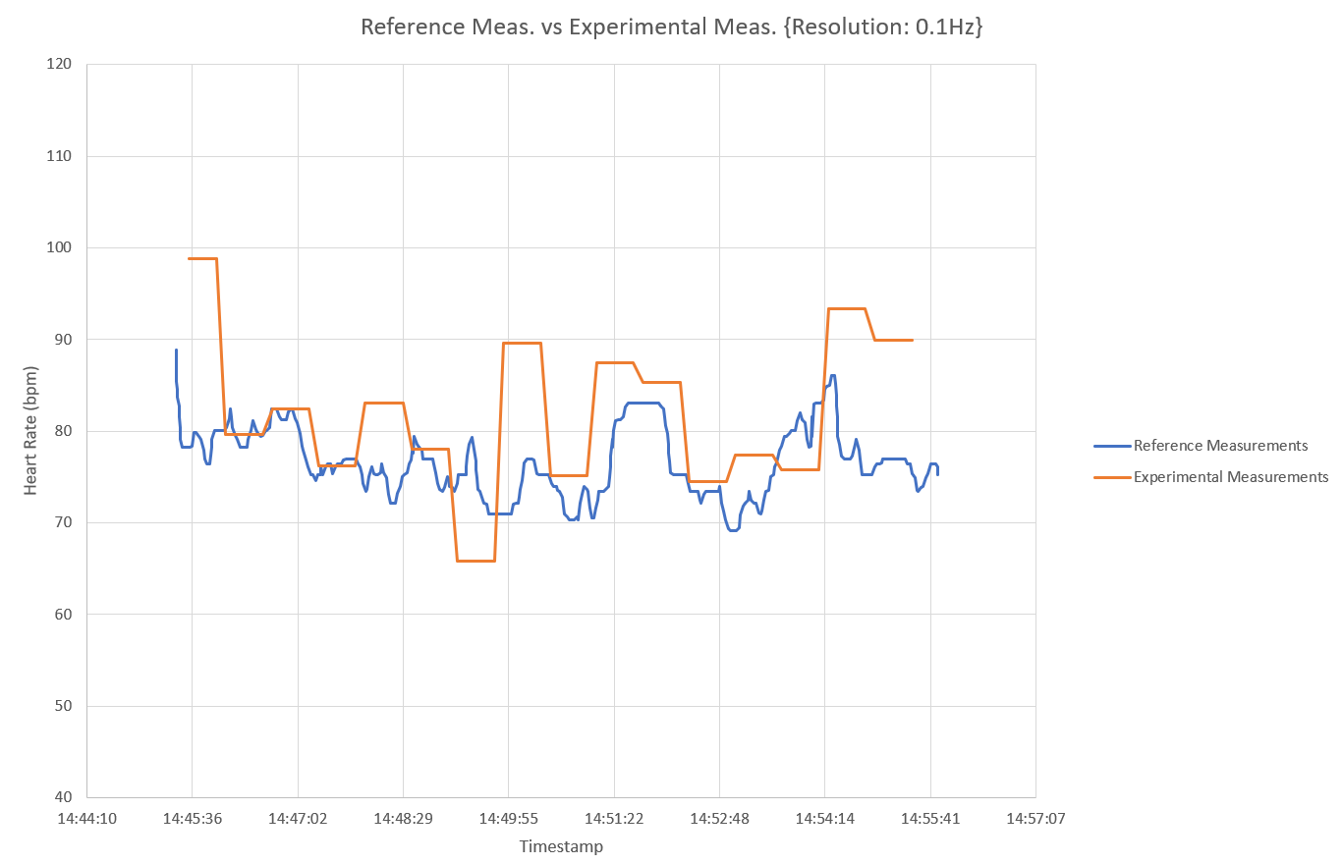
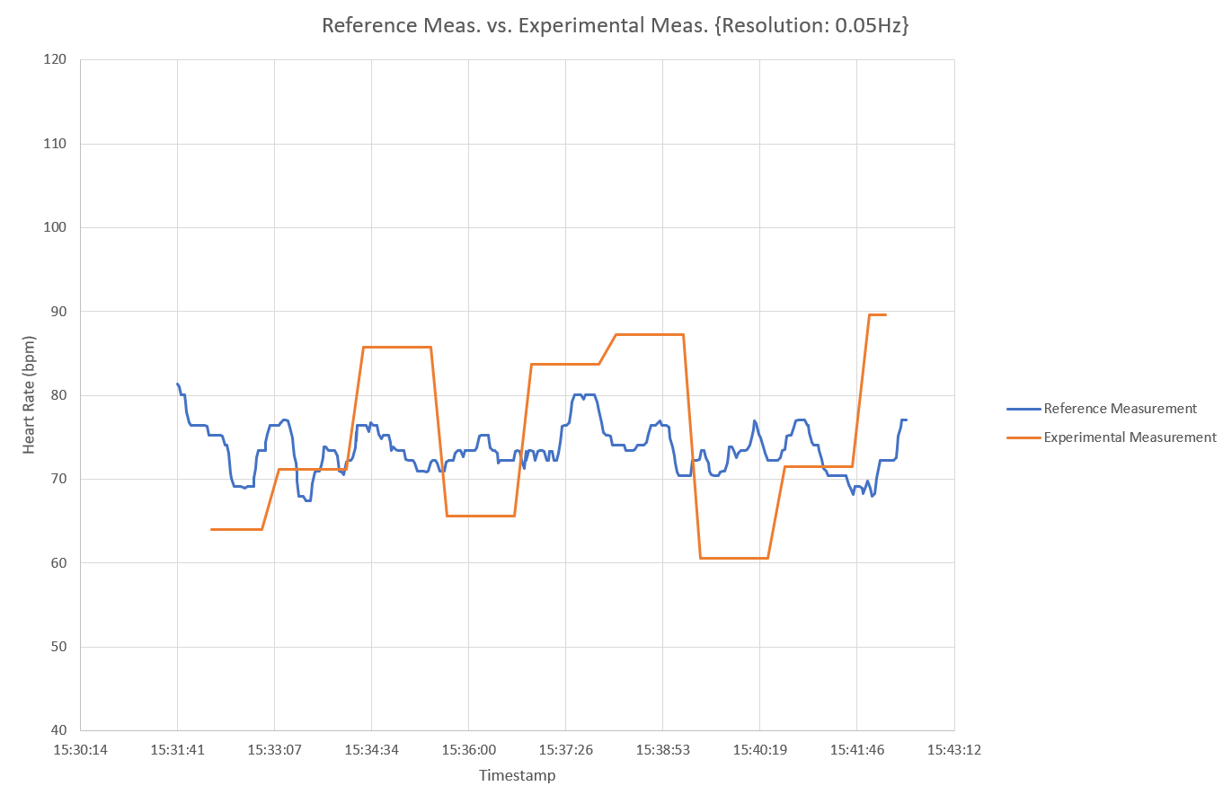


4-Tap moving average filter
Similar in design to the 8-tap filter shown first, however the window has now been halved in length. This doubles the speed of performance. The test results for both 0.1Hz resolution and 0.05Hz resolution are listed respectively below
This design shows greatly improved performance on all fronts compared to the 8-tap moving average filter. All error values have decreased markedly.

Slide 6
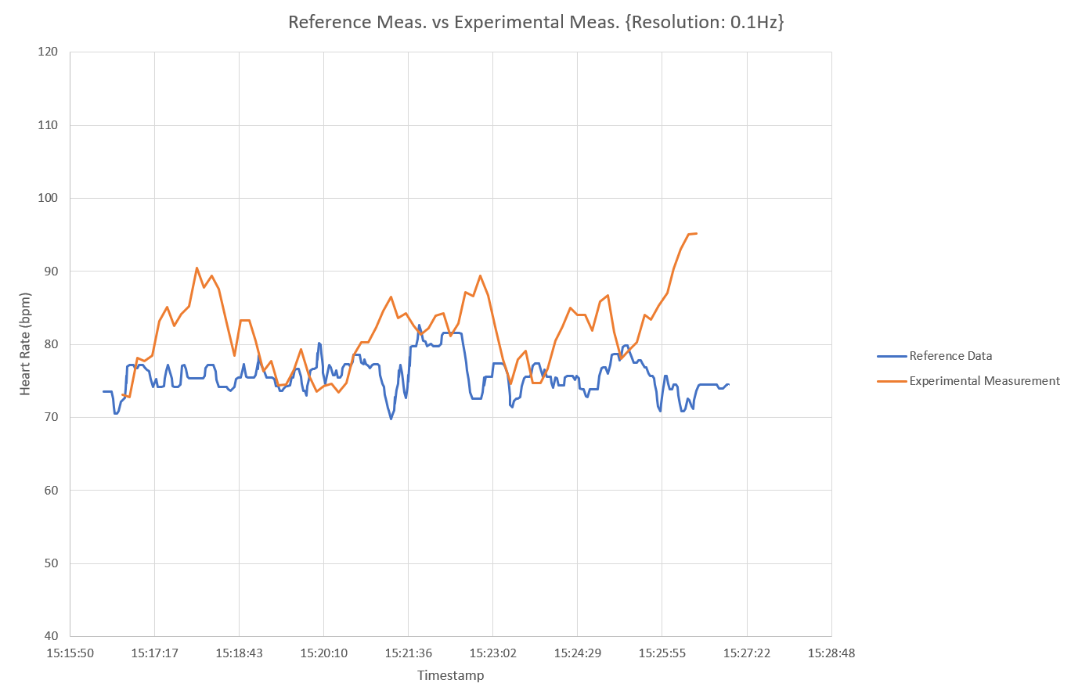

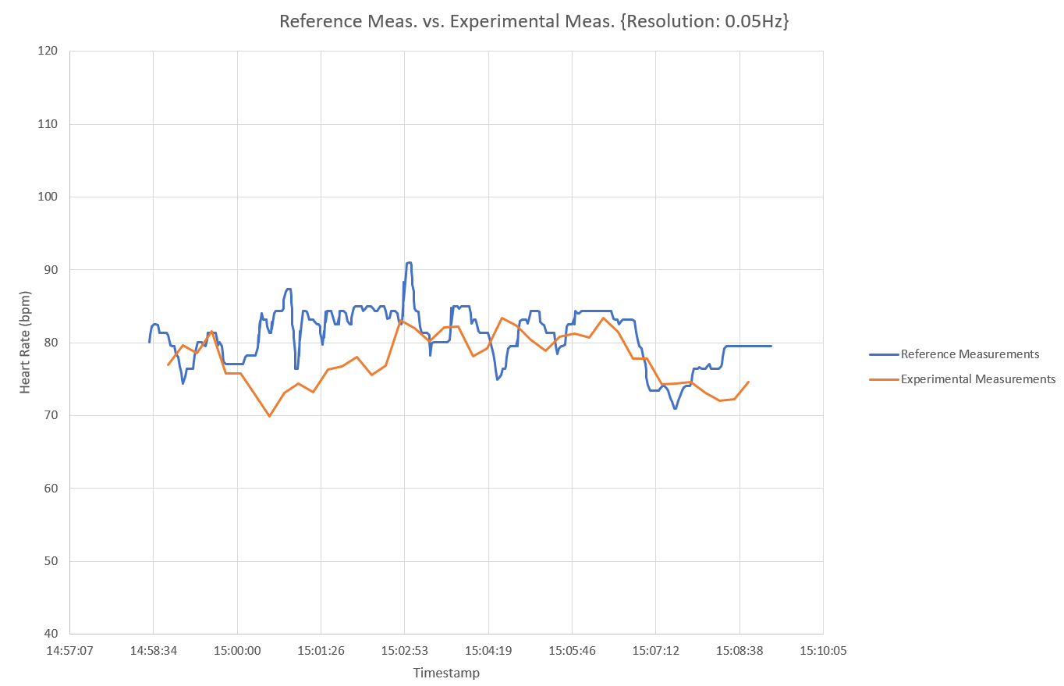

1-tap sliding window filter
Similar to the Gaussian filter from before, however now the 8-sample buffer is simply averaged. Results are listed for 0.1Hz and 0.05Hz resolution respectively:
This design shows a huge improvement on the Gaussian design, having lower error margins, if perhaps a worse average error value. Having said this, the increased average error is more than justified by the huge decrease in standard deviation.

Slide 7
Brief wrap up
The behaviour of the 4-tap moving average filter and the 1-tap sliding window filter seem promising.
Ideally more testing would be performed to characterise these designs, as well as other filter designs, more completely, however this was not feasible in these experiments due to time constraints
The major choke point for the design as a whole is the speed. MATLAB is slow and does not work in real-time applications readily. Porting this design to the Blackfin and running on the board would likely prove to be a major advantage.

Slide 8
Questions?

